Slide 1






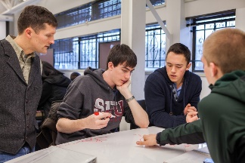

Physics Learning Resources
Textbook
PhET, Veritasium, etc.
SPU Physics Learning Resources
  Interactive Video Vignettes
  Modeling Metacognitive Physics Reasoning
Learning Assistants
Detailed Responsive Online Course Schedule
Learning
Supports
Provides ongoing support
Priming Assignments:
New Physics Ideas
Scientific Reasoning
Learning Strategies
Online Physics
Problem Solving
(Mastering Physics)
Learning
Experiences
Classroom Learning Experiences
Collaborative Physics Learning
Sessions
Transformative Learning
Sophisticated, Collaborative Scientific Thinkers:
Defining and refining problems
Applying and evaluating models
Communicating and collaborating
Products of Exemplary Physics Reasoning:
Individual (e.g., Quizzes and Homework)
Collaborative (e.g., Homework
and Projects)
Learning
Outcomes

